Slide 1
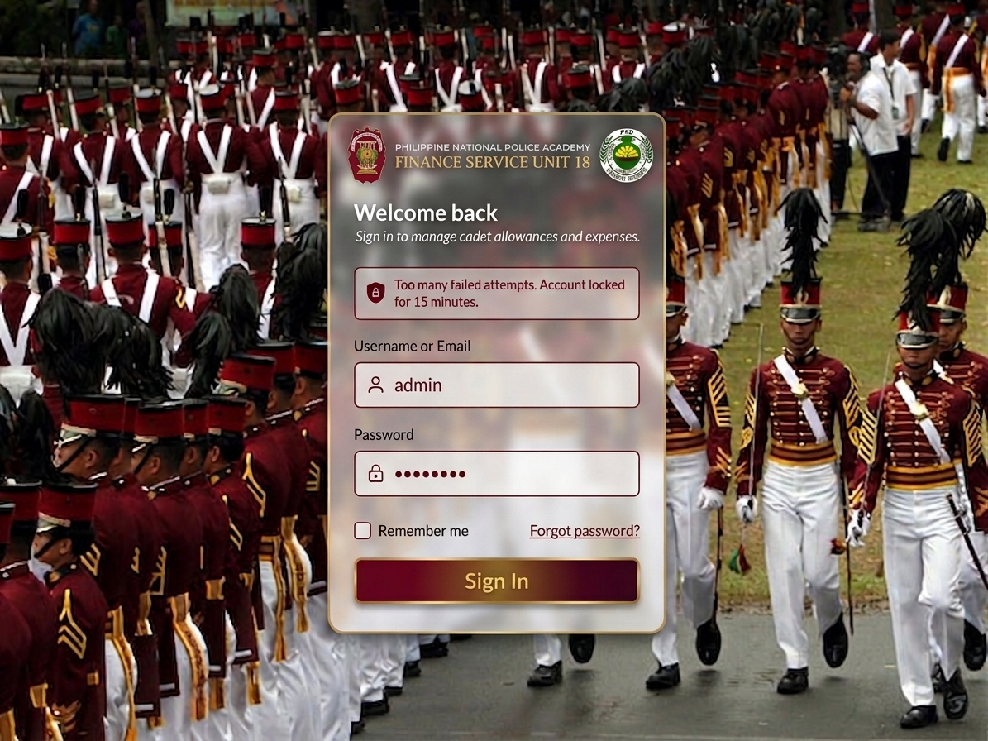
Log In Page & Access Restriction
Name | Designation | Access Restriction
PCOL Reyman G Tolentin | Chief, FSU PNPA | ALL Access
PLTCOL Sheryl O Macarangal | Assistant Chief, FSU PNPA | ADMINISTRATOR
PEMS Carol Joyce A Panganiban | Chief Clerk / Admin PNCO | ADMINISTRATOR
PSMS Rufino C Mateo | PAS / Training PNCO | CO – ADMIN
PSMS Abigail G Gonzales | MDS / Finance PNCO | ALL Access
PSMS Alexis E Madarang | Asst. MDS / Bookkeeper | CO – ADMIN
PMSg Marlon P Legion | Logistics PNCO | VIEWER
PMSg Claimar Q Dacumos | Asst. Admin PNCO | CO – ADMIN
PSSg Vien Lionel Pelayo | Asst. PAS / Supply | CO – ADMIN
NUP Lyka L Retaga | Collecting NUP | CO – ADMINI
Note:
Pagdating po sa ating Restrictions (kung ikaw ay collection staff, yung COLLECTION COLUMN lang yung ma-access, the same sa other officers or staff)

Slide 2
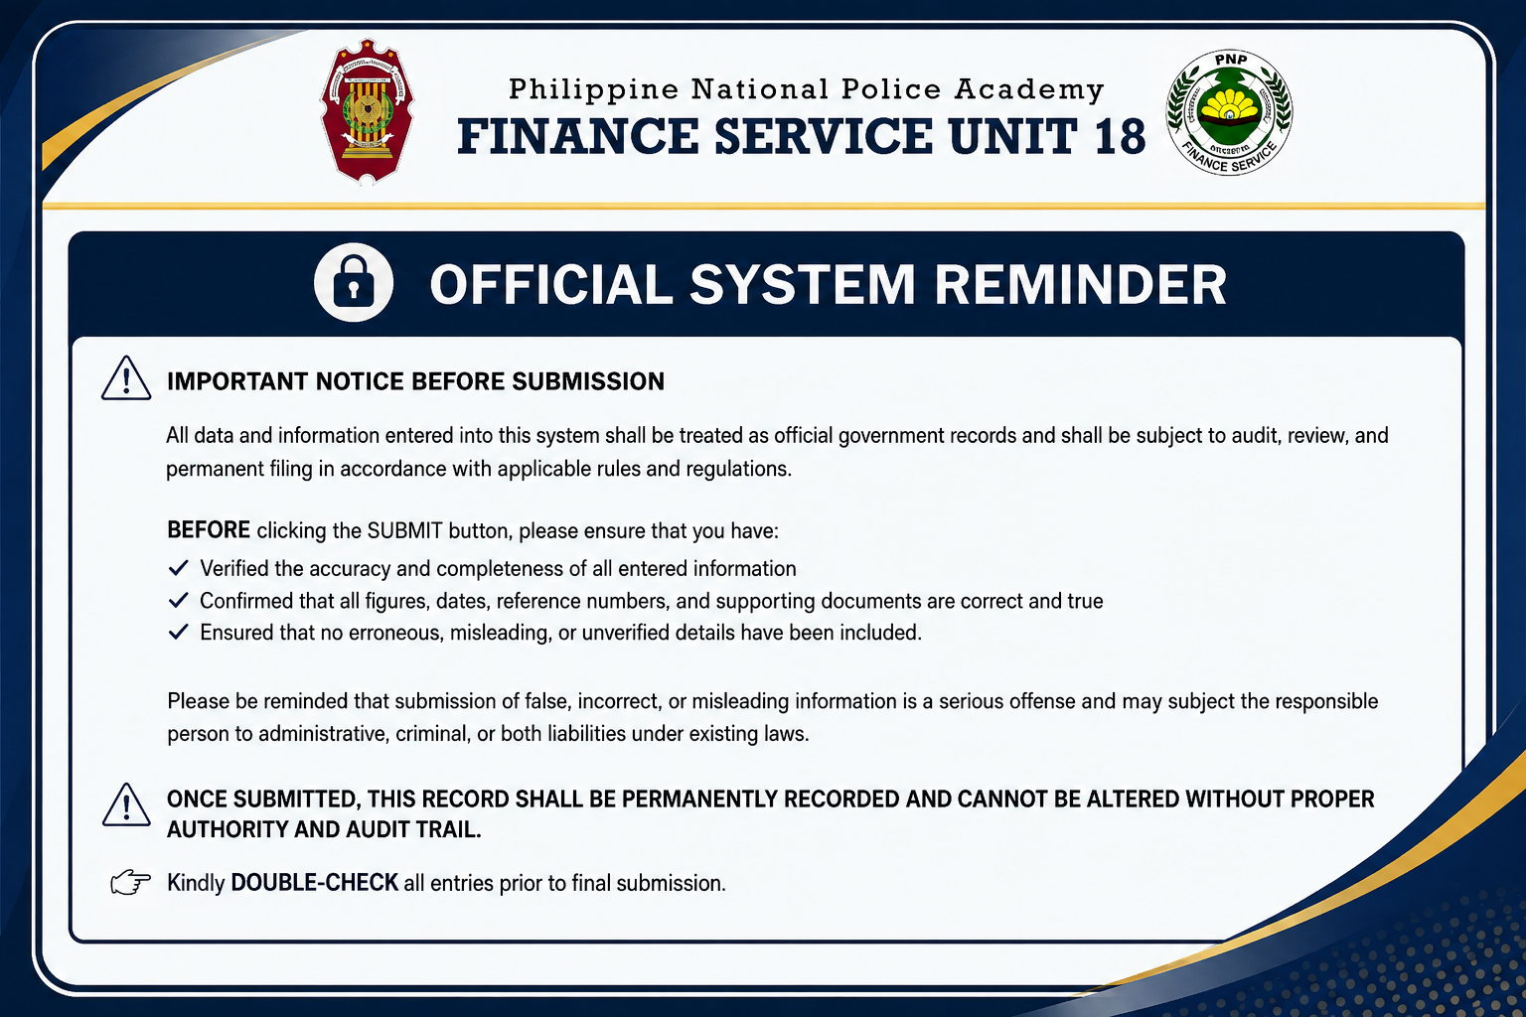

I UNDERSTAND
After Logging In, ito po yung Landing Page FOR SHORT SYSTEM REMINDER – THEN AFTER CLICKING (I UNDERSTAND BUTTON) LALABAS NA PO (ito yung 5 modules from Admin to Collection) then sa bawat modules limitado lang yung may access. (To follow po yung UPDATED RESTRICTION ACCESS Lists ng Admin, Co – Admin, and Viewers)

Slide 3

Philippine National Police Academy
FINANCE SERVICE UNIT 18
Administrator
Disbursement
Remittance
Pay & Allowances
Collection
To Followed Requirements
Maam Abi
Done
Done
Done

Slide 4
Philippine National Police Academy
FINANCE SERVICE UNIT 18
Administrator
To Followed Requirements
After CLICKING I UNDERSTAND, ito na po yung Landing Page.

Slide 5
Philippine National Police Academy
FINANCE SERVICE UNIT 18
Disbursement
Maam Abi
Correct sample kung siya ay nag log in as Disbursement, yun lang ma-access niya.

Slide 6
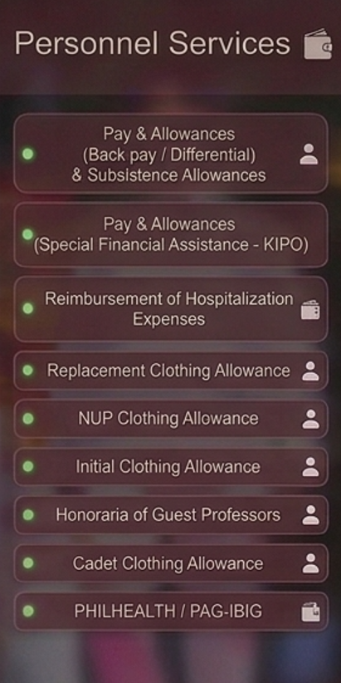
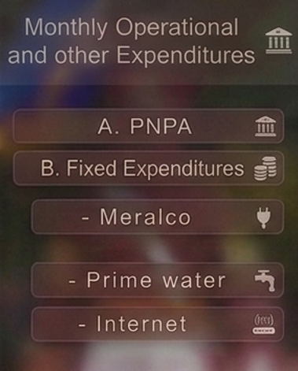
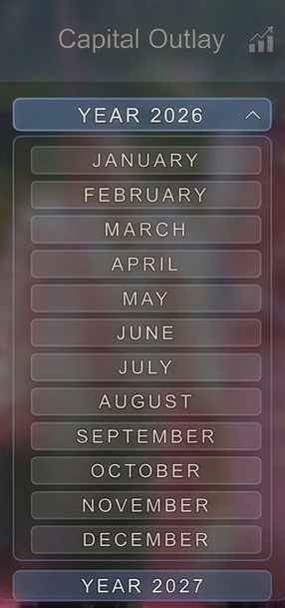
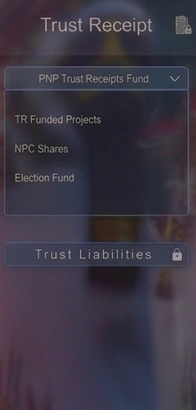
Philippine National Police Academy
FINANCE SERVICE UNIT 18
Modified Disbursement System
Personnel Services
MOOE
Capital Outlay
Trust Receipt
Under ni Disbursement, ito po yung Layout and Requirements (nasa picture po yung sample landing page – printed copy)

Slide 7
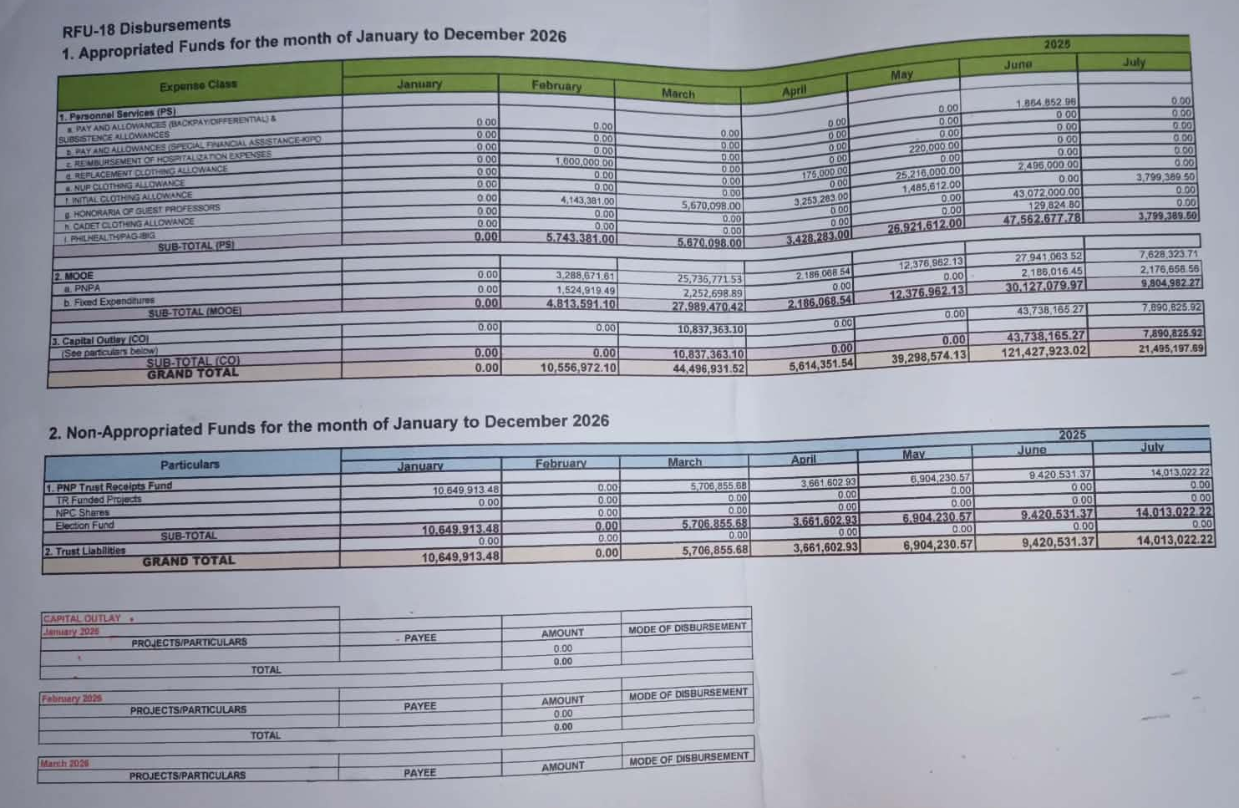

Slide 8
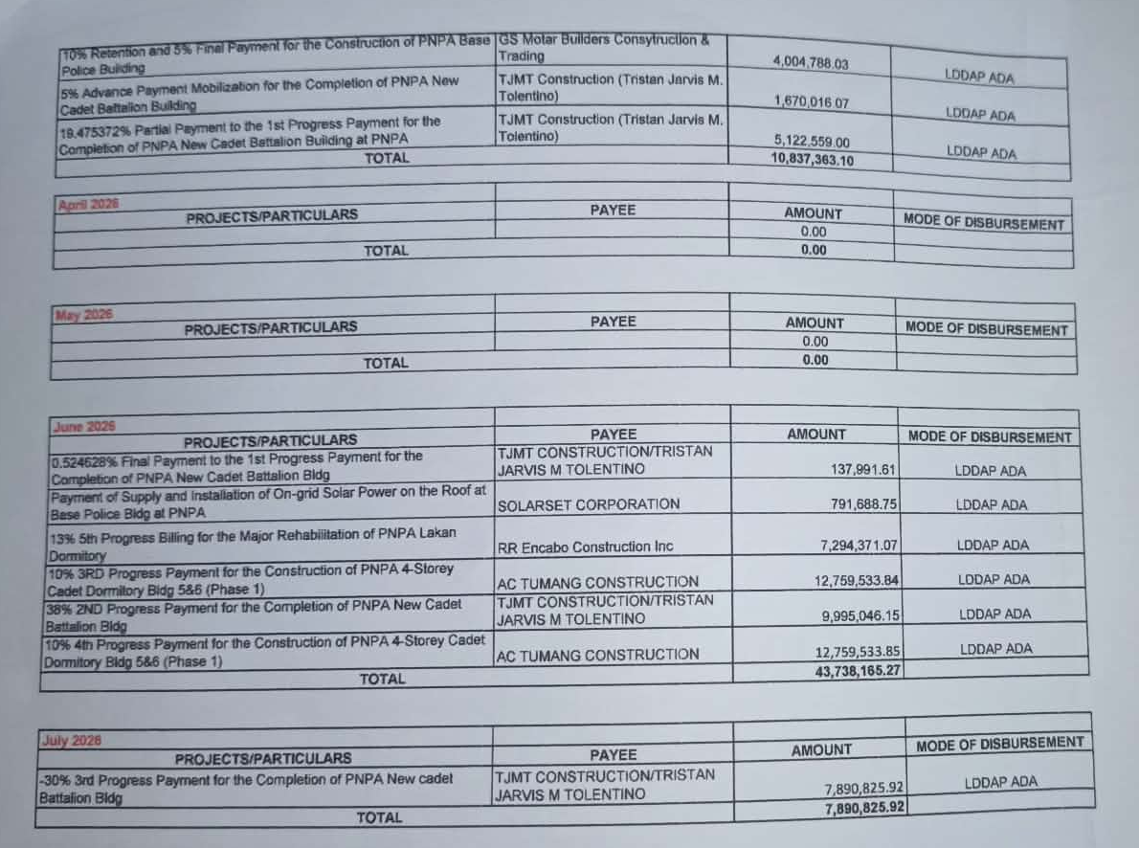

Slide 9
Philippine National Police Academy
FINANCE SERVICE UNIT 18
Administrator
Disbursement
Remittance
Pay & Allowances
Collection
To Followed Requirements
Maam Abi
Done
Done
Done
Next is yung Remittance column

Slide 10
Philippine National Police Academy
FINANCE SERVICE UNIT 18
REMITTANCE
Successfully Uploaded!
PAG IBIG
Uploaded Files
Date Filtered
(Dropdown)
Every uploading of files
(Ascending Order)
PHILHEALTH
Choose File
UPLOAD
DISCARD
Ito na yung last wireframe bro ng Remittance column (next is the Pay & Allowances)

Slide 11
Philippine National Police Academy
FINANCE SERVICE UNIT 18
Pay & Allowances
To Follow COMPUTATION
TO FOLLOW REQUIREMENTS
DISPLAY IN LANDING THE (FILTERED FILE)
Monthly Filtered
Upload File
**Stored as PDF File
PAYSLIP
TURNBACK
PAYSLIP
PAYSLIP
READMITTED
PAYSLIP
PAYSLIP
PAYSLIP

Slide 12
Philippine National Police Academy
FINANCE SERVICE UNIT 18
Pay & Allowances
TURNBACK
To Follow COMPUTATION
For COMPUTATION
Total payslip – days of duty
Ibawas kung ilang araw lang pinasok sa total ng pumasok na sahod
DISPLAY IN LANDING THE (FILTERED FILE)
Monthly Filtered
Upload File
**Stored as PDF File
PAYSLIP
PAYSLIP
PAYSLIP
READMITTED
PAYSLIP
PAYSLIP
PAYSLIP

Slide 13
Philippine National Police Academy
FINANCE SERVICE UNIT 18
Pay & Allowances
RE-ADMITTED
For COMPUTATION
Total payslip – days of duty
Ibawas kung ilang araw lang pinasok sa total ng pumasok na sahod
DISPLAY IN LANDING THE (FILTERED FILE)
Monthly Filtered
Upload File
**Stored as PDF File
PAYSLIP
TURNBACK
PAYSLIP
PAYSLIP
PAYSLIP
PAYSLIP
PAYSLIP

Slide 14
Philippine National Police Academy
FINANCE SERVICE UNIT 18
Collection
After Logging In, ito na yung Landing Page (ito yung 5 modules from Admin to Collection) then sa bawat modules limitado lang yung may access. (To follow po yung UPDATED RESTRICTION ACCESS Lists ng Admin, Co – Admin, and Viewers)

Slide 15
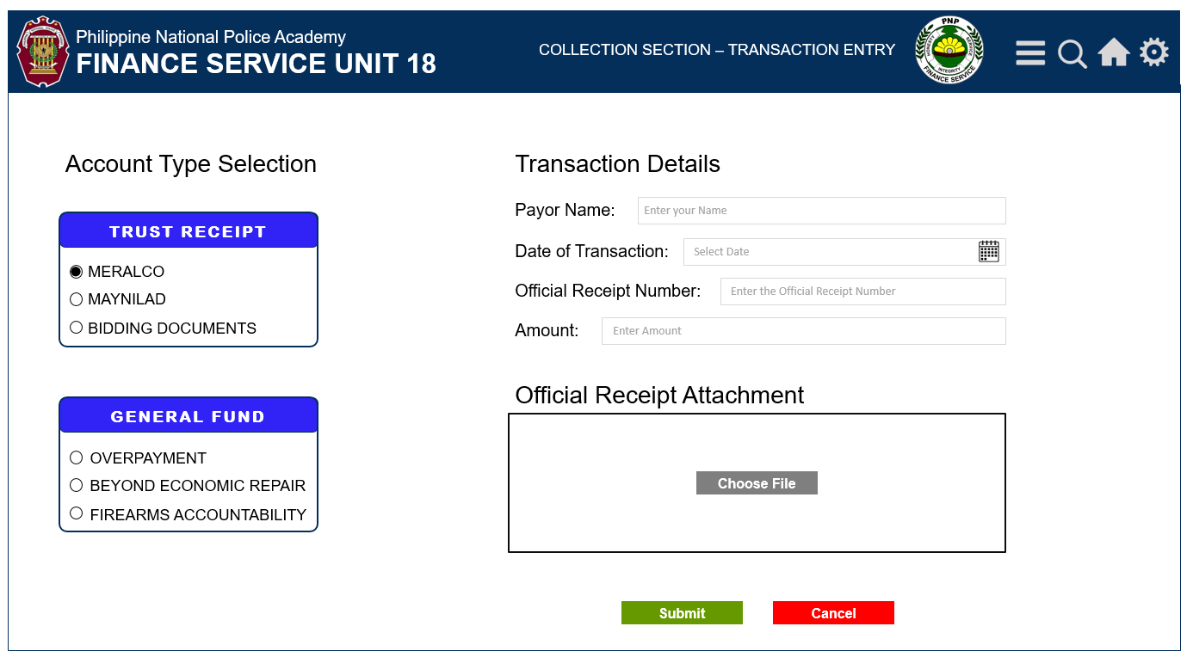
Philippine National Police Academy
FINANCE SERVICE UNIT 18
Collection System
Collection
TRANSACTIONS
REPORTS
Under ni COLLECTION ito po yung Layout and Requirements, pag ka CLICK po ng TRANSACTIONS BUTTON, ito po yung Landing page niya.

Slide 16




Philippine National Police Academy
COLLECTION SECTION – TRANSACTION ENTRY
FINANCE SERVICE UNIT 18
Account Type Selection
Transaction Details
Payor Name:
Enter your Name
TRUST RECEIPT
Date of Transaction:
Select Date
LIGHT
WATER
Official Receipt Number:
Enter the Official Receipt Number
BIDDING DOCUMENTS
Amount:
Enter Amount
Official Receipt Attachment
GENERAL FUND
OVERPAYMENT
BEYOND ECONOMIC REPAIR
Choose File
FIREARMS ACCOUNTABILITY
Submit
Cancel

Slide 17
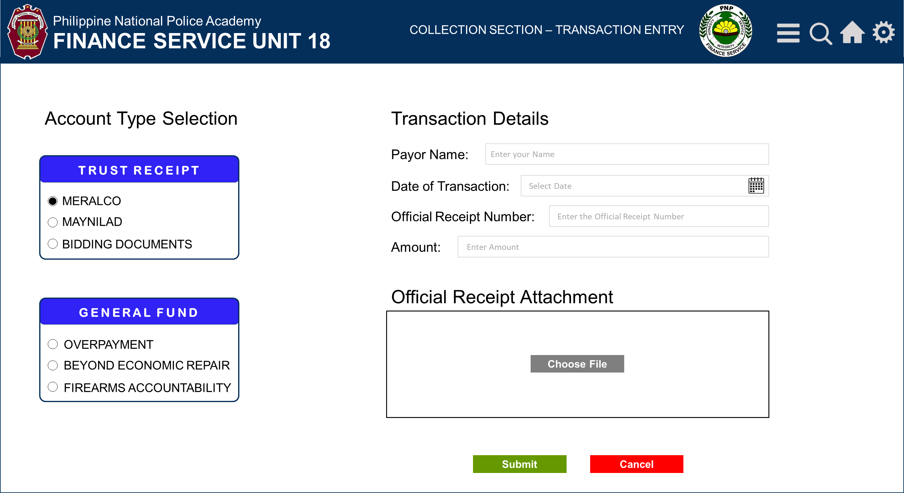
Philippine National Police Academy
FINANCE SERVICE UNIT 18
Optional nalang itong part, if may pag gagamitan, pasuyo nalang po.
Collection System
Collection
TRANSACTIONS
Generated Reports (Sorted view)
Daily
Monthly
**By date range (transaction based)
**from aug 26 – sept 25
Generated report (print)
Hardcopy sample** - ito yung dina nila na ibigay satin kaka alok ng merienda potek, pero follow up ko bukas si Teacher Lyka
Prepared by:
Time Stamp:
REPORTS

Slide 19
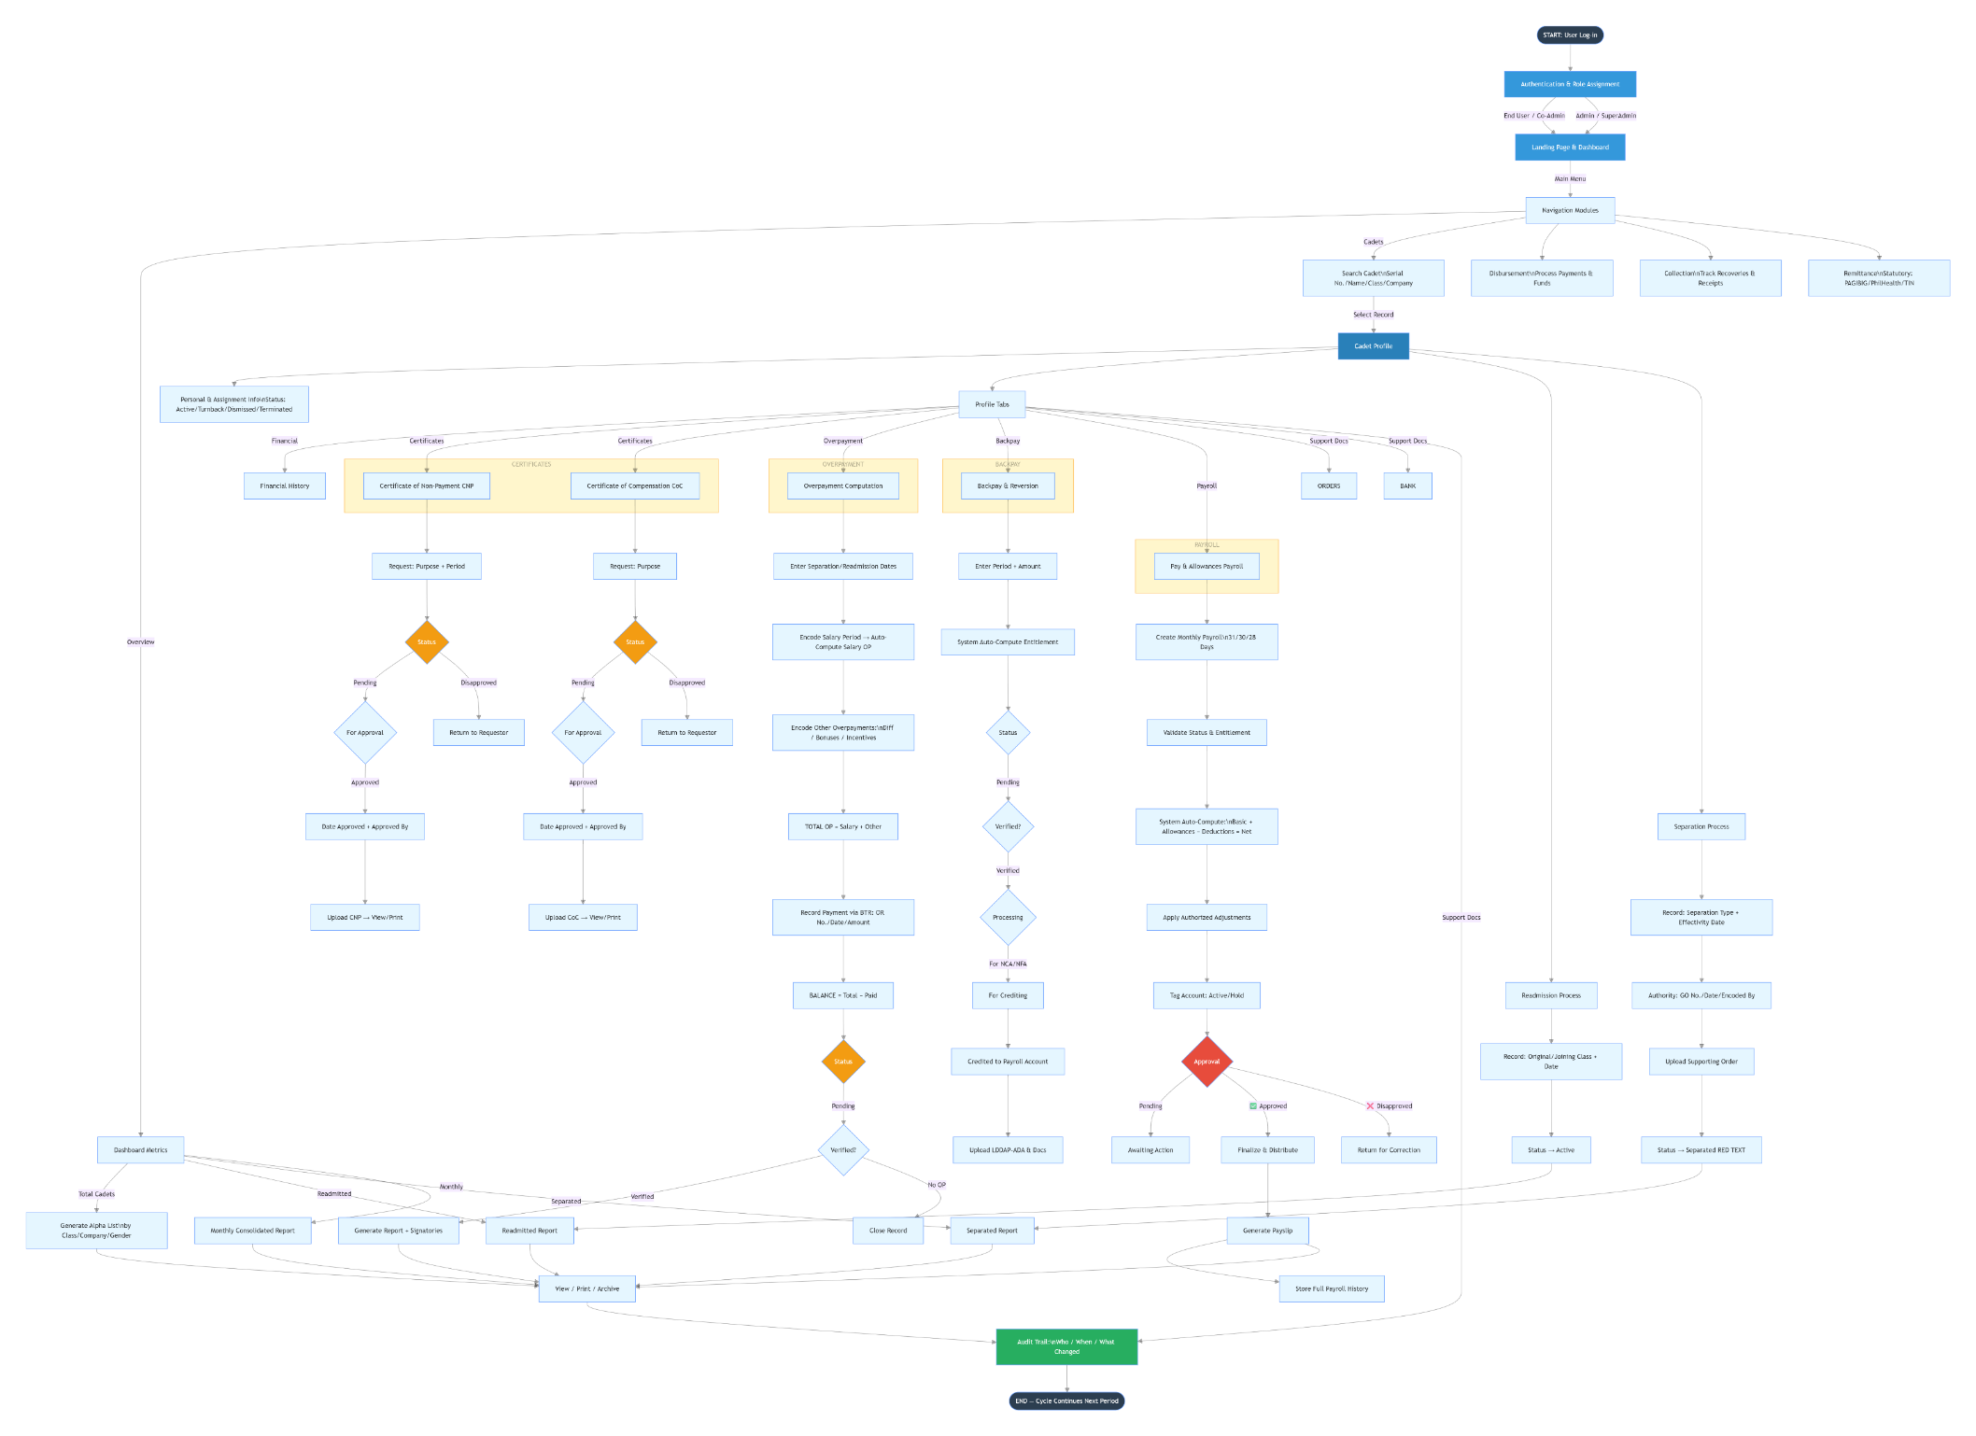
in-insert ko lang incase need ng idea

